Slide 1



DEPARTMENT OF COMPUTER SCIENCE & ENGINEERING
SCHOOL OF COMPUTING
10214CS602 MINOR PROJECT -2
WINTER SEMESTER(2023-2024)
REVIEW-1I
“MEDICLASSIFY: AI POWERED MEDICAL IMAGE DIAGNOSIS”
SUPERVISED BY
PRESENTED BY
Ms. S.HANNAH,ME
1.R.Dasaradh (VTU19246)(21UECS0716)
2.A.Navya Sri (VTU19455)(21UECS0021)
3.S.Gowthami (VTU20520)(21UECS0544)

Slide 2
OVERVIEW
ABSTRACT
OBJECTIVES
TIMELINE OF THE PROJECT
INTRODUCTION
LITERATURE REVIEW
DESIGN AND METHODOLOGIES
IMPLEMENTATION
CONCLUSION
REFERENCES

Slide 3
ABSTRACT
INTRODUCTION:
Our project, MediScanAI, aims to revolutionize medical diagnosis using artificial intelligence (AI).
By leveraging advanced machine learning techniques, we have developed a system that can analyze medical images such as X-rays and MRIs to assist healthcare professionals in making accurate diagnoses.
Our project has the potential to significantly impact the field of healthcare by providing a cost-effective and accessible solution for medical diagnosis.

Slide 4
PURPOSE:
Develop an AI-powered system capable of analyzing medical images, such as X-rays and MRIs, to assist healthcare professionals in making accurate diagnoses.
Create a user-friendly web platform where users can upload their medical images for analysis and receive instant diagnostic insights.
Improve patient care and healthcare outcomes by providing a cost-effective and accessible solution for medical diagnosis.

Slide 5
METHOD:
Collect and preprocess a dataset of labeled medical images, including X-rays and MRIs, to train the AI model.
Develop and train a convolutional neural network (CNN) using deep learning techniques to analyze medical images and make diagnostic predictions.
Integrate the trained AI model into a user friendly web- platform, allowing the users to upload the medical images for analysis.

Slide 6
RESULT:
Successful development of an AI-powered system capable of accurately analyzing medical images, such as X-rays and MRIs, for diagnostic purposes.
Creation of a user-friendly web platform that allows users to upload medical images and receive instant diagnostic insights, contributing to improved accessibility and efficiency in healthcare.
Potential positive impact on patient care and healthcare outcomes by providing healthcare professionals with a cost-effective and accessible tool for medical diagnosis, leading to timely interventions and improved treatment decisions.

Slide 7
CONCLUSION:
The developed AI-powered system demonstrates promising capabilities in accurately analyzing medical images for diagnostic purposes, potentially assisting healthcare professionals in making timely and informed decisions.
he user-friendly web platform provides a convenient and accessible means for users to upload their medical images and get the responses.

Slide 8
OBJECTIVES
AIM OF THE PROJECT:
Develop an AI-powered system capable of analyzing medical images to assist in diagnosing various conditions and abnormalities.
Create a user-friendly web platform that allows users to upload medical images for analysis and receive instant diagnostic insights, ultimately improving the efficiency and accuracy of medical diagnosis.
SCOPE OF THE PROJECT:
The project focuses specifically on medical image analysis using deep learning techniques. It includes preprocessing of medical images, model training, and integration into a web application.
It focusses on the giving the accurate information about the medical image given as input by the user by specifying the abnormality in it.

Slide 9
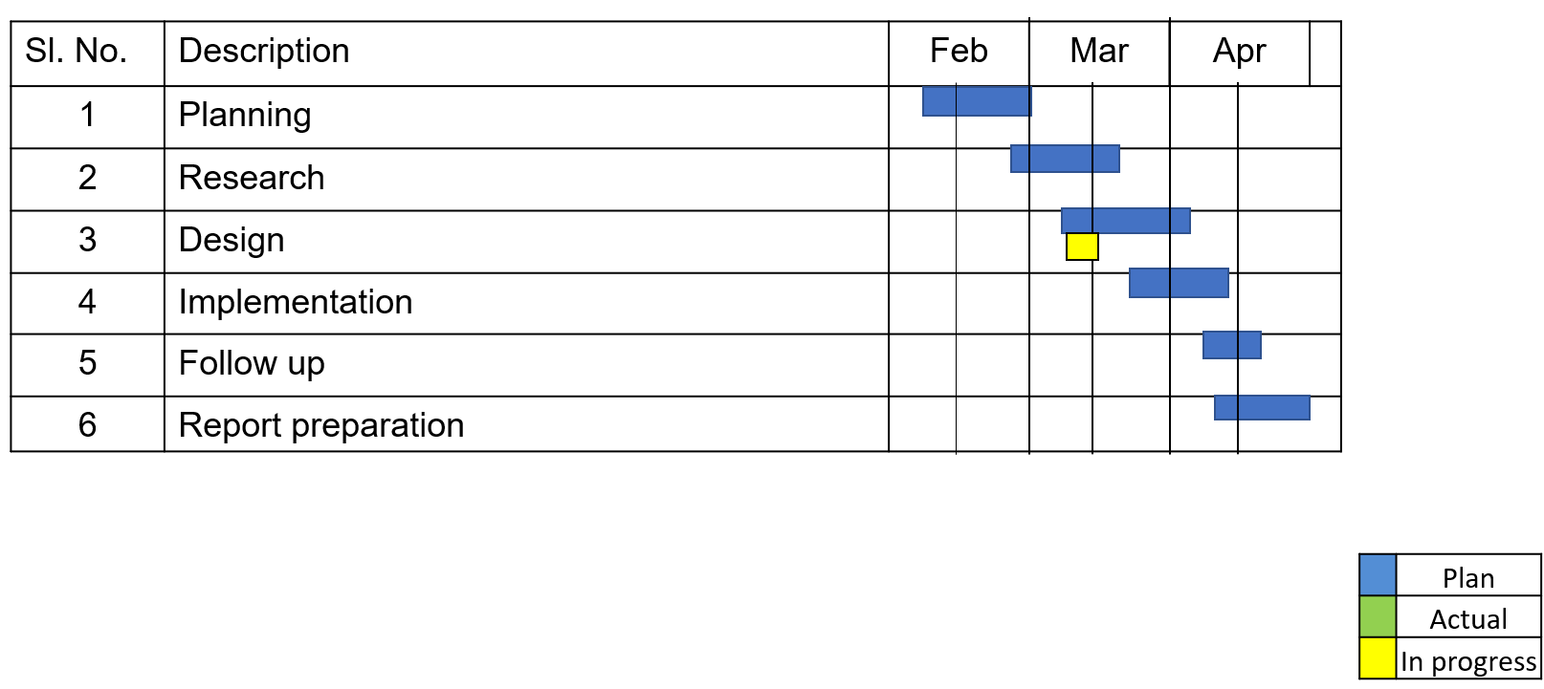
TIMELINE OF THE PROJECT

Slide 10
INTRODUCTION
Our project, MediScanAI, aims to revolutionize medical diagnosis using artificial intelligence (AI).
By leveraging advanced machine learning techniques, we have developed a system that can analyze medical images such as X-rays and MRIs to assist healthcare professionals in making accurate diagnoses.
Our project has the potential to significantly impact the field of healthcare by providing a cost-effective and accessible solution for medical diagnosis.
Utilize deep learning techniques to train a model capable of analyzing X-rays and MRIs for abnormalities and conditions.
The project aims to improve patient care and healthcare outcomes by providing a cost-effective and accessible solution for medical diagnosis.

Slide 11
LITERATURE REVIEW
Author’s Name | Paper name and publication details | Year of publication | Main content of the paper
Litjens, Geert et al. | “A survey on deep learning in medical image analysis" | 2019 | This paper provides a comprehensive survey of deep learning techniques applied to medical image analysis.
Shen, Dinggang et al. | "Deep Learning in Medical Image Analysis" | 2019 | It discusses the architecture of convolutional neural networks (CNNs), their applications in medical imaging tasks, and the challenges associated with training and interpreting these models.

Slide 12
Author’s Name | Paper name and publication details | Year of publication | Main content of the paper
Rajpura, Pranav et al. | “CheXNet: Radiologist-Level Pneumonia Detection on Chest X-Rays with Deep Learning" | 2021 | The paper introduces CheXNet, a deep learning model trained to detect pneumonia in chest X-rays.
Esteva, Andre et al. | "Dermatologist-level classification of skin cancer with deep neural networks" | 2023 | It discusses the challenges of interpreting deep neural networks and the importance of addressing issues related to model interpretability and generalization in medical image analysis.
Topol, Eric J et al. | "High-performance medicine: the convergence of human and artificial intelligence." | 2020 | This paper explores the convergence of human expertise and artificial intelligence in high-performance medicine.

Slide 13
DESIGN AND METHODOLOGIES
MODULE 1: Decision tree
New medical image required
Format ok?
YES
NO
Analyze image
Incompatible image
YES
Abnormality
NO
Display as normal reading
Identify & score abnormality
Refer the spcilialist to consult.

Slide 14
DECISION TREE:
Decision tree is a popular machine learning algorithm used for classification and regression tasks. It works by recursively partitioning the feature space into smaller subsets based on the value of input features, creating a tree-like structure of decision rules.
a decision tree can be trained on features extracted from medical images to classify them into different categories, such as normal vs. abnormal or specific disease classes.
It explains how the process is going on in the system and explains about various functions that takes place

Slide 15
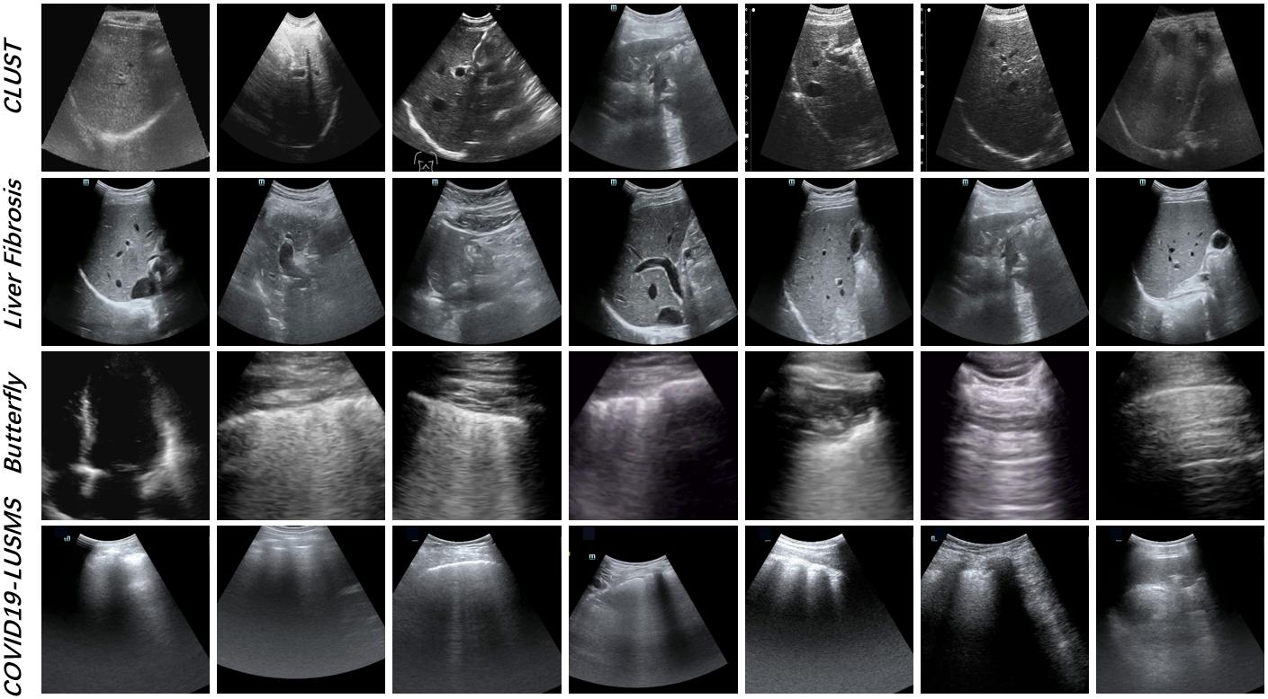
MODULE 1: Collection and Processing of data
Step:1 Collection of data

Slide 16
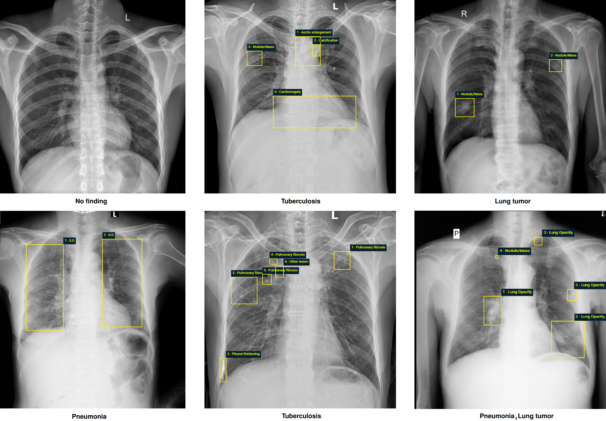
Step 2: Processing the data

Slide 17
Module 2- CNN Algorithm
CNN ALGORITHM:
A CNN is a deep learning algorithm specifically designed for processing structured grid data, such as images. It consists of multiple layers, including convolutional layers, pooling layers, and fully connected layers. CNNs are highly effective for image classification, object detection, and other computer vision tasks.
In the context of medical image analysis, CNNs use convolutional layers to extract features from input images. Each convolutional layer applies a set of filters (also called kernels) to the input image, detecting patterns such as edges, textures, or shapes.
For example, in the case of chest X-rays or MRI scans, the convolutional layers can learn to detect specific anatomical structures or abnormalities relevant to the diagnosis of medical conditions.

Slide 18
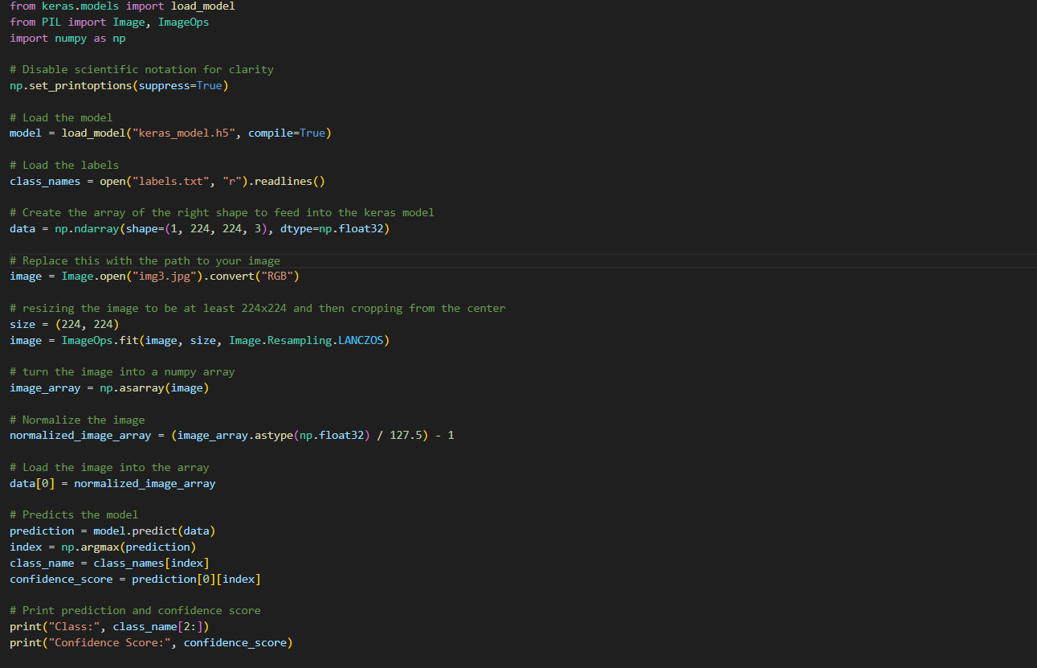
Step 3: Using algorithm’s CNN algorithm

Slide 19
IMPLEMENTATION
Architecture Diagram
Data –Flow Diagram
Use Case Diagram
Class Diagram
Activity Diagram
Sequence Diagram
Collaboration Diagram(If applicable)
E-R Diagram

Slide 20
Architecture Diagram
User interface
Training and fine tuning
Secure upload
(web platform)
Output
Data preprocessing
(Resize, Normalize)
Abnormality detection in the image
Pretrained model action on images
Suggesting specialist doctor to be consult
The Architecture diagram explains about the mechanism that was happening inside the system. It gives the proper idea about how the functions takes place in order to meet the user needs.

Slide 21
Data –Flow Diagram
User interface
Suggesting specialist doctor to be consult
Secure upload
(web platform)
Medical image diagnosis
Pretrained model action on images
Abnormality detection in the image
Data preprocessing
(Resize, Normalize)

Slide 22
Use Case Diagram
User interface
Secure upload(web platform)
Data preprocessing
CNN model
User
Works on medical image dataset
Training and finetuning
Trained model
Abnormality detection and specialist referral
Use Case Diagram serves as a visual representation of the different interactions between users (actors) and the system (use cases. t helps to identify the various functionalities or features that the system provides and how users interact with these functionalities)

Slide 23
Class Diagram
User login
Upload image
Proceed
USER
Model Architecture
Weights
Predict (image- data)
Model
Image data
Type (X-ray, MRI)
Modality
IMAGE
Resize image
Normalize image
Image abnormality
Domain(Ex: heart)
Refer specilaist
PREPROCESSOR
ANALYSIS RESULT

Slide 24
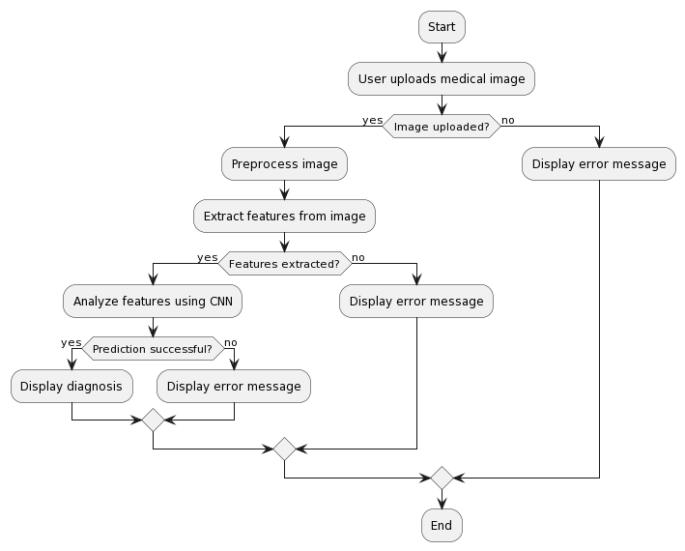
Activity Diagram

Slide 25
Sequence Diagram
USER
WEB PLATFORM
IMAGE
MODEL
DATABASE
Login
Send image for analysis
Upload image
Authentication
Login successful
Return result
Login successful
Store image
Store analysis result
Display analysis result

Slide 26
E-R Diagram
Password
Modality
Image-data
U-name
Age
Image-id
Can upload
IMAGE
USER
Give input
Has one
Disease specification
Abnormality
Upload
WEB PLATFORM
Send image
Analysis result
Specialist referral
Login
Data connectivity
Return result

Slide 27
TESTING
UNIT TESTING
INTEGRATION TESTING
FUNCTIONAL TESTING
WHITE BOX TESTING
BLACK BOX TESTING

Slide 28
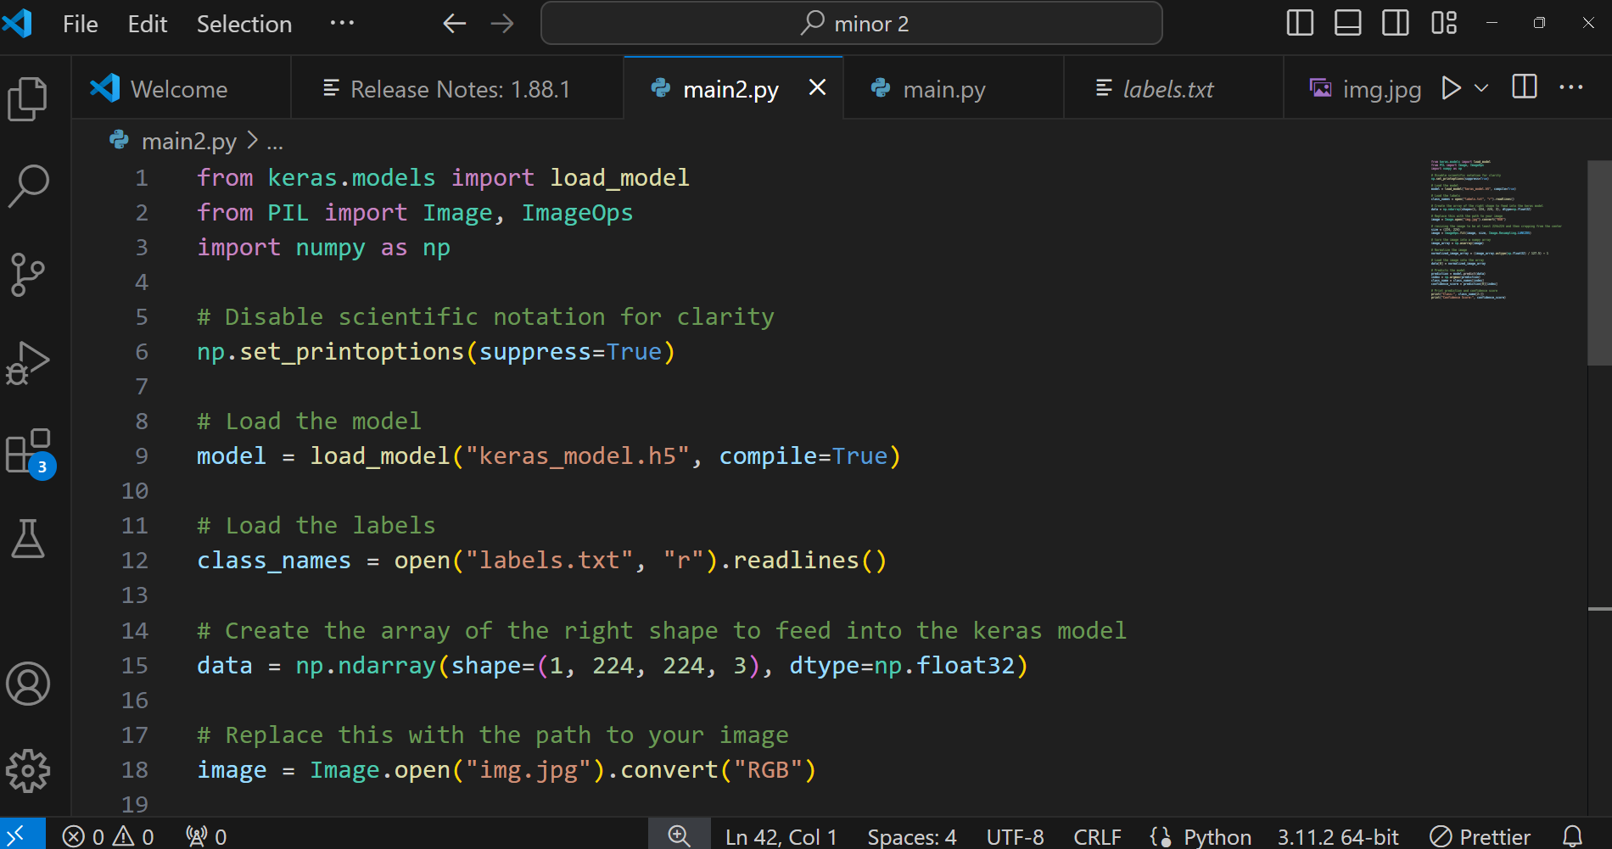
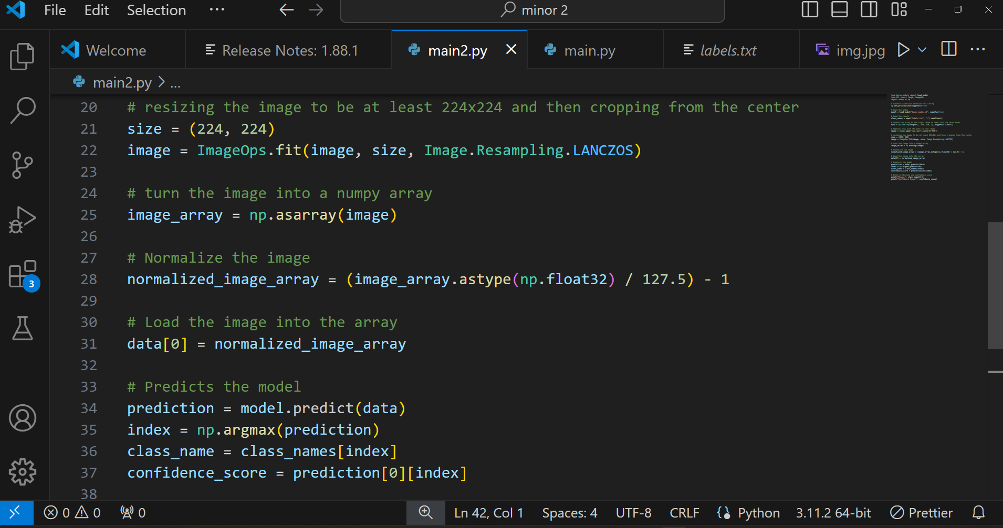
UNIT TESTING

Slide 29
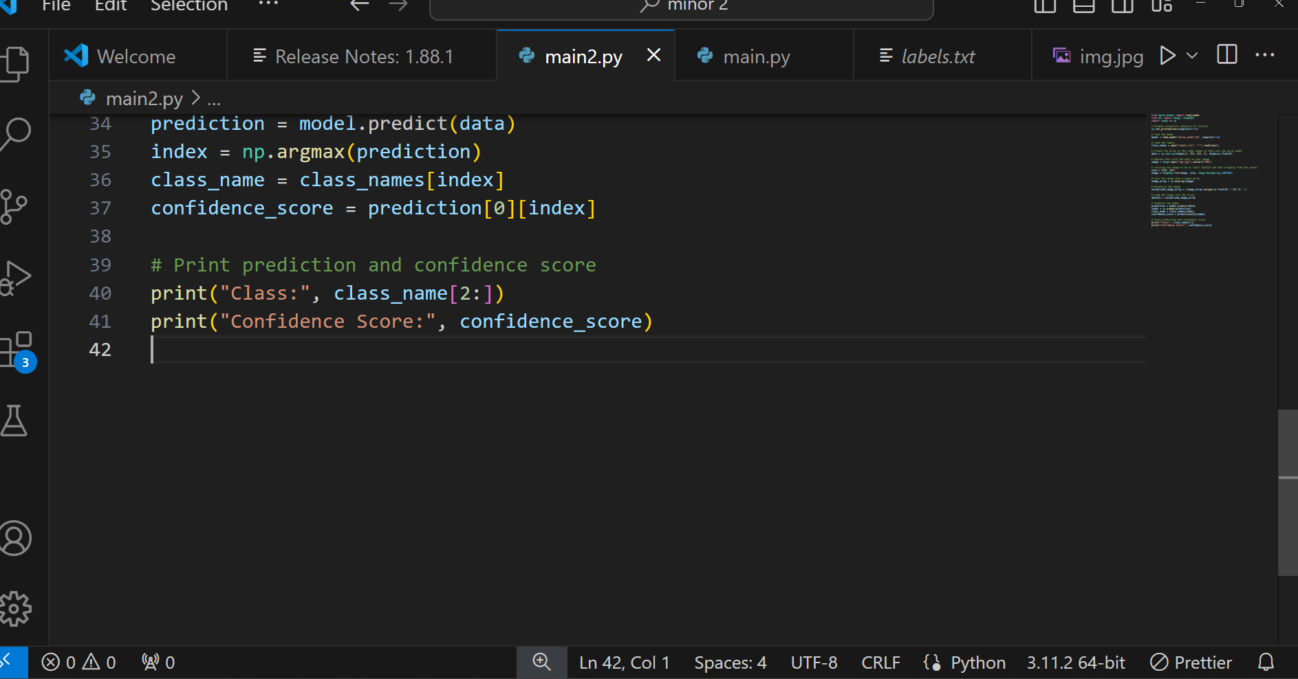
UNIT TESTING
Unit testing ensures that individual components such as data preprocessing functions and model architecture are functioning correctly by validating their behavior against expected outcomes.

Slide 30
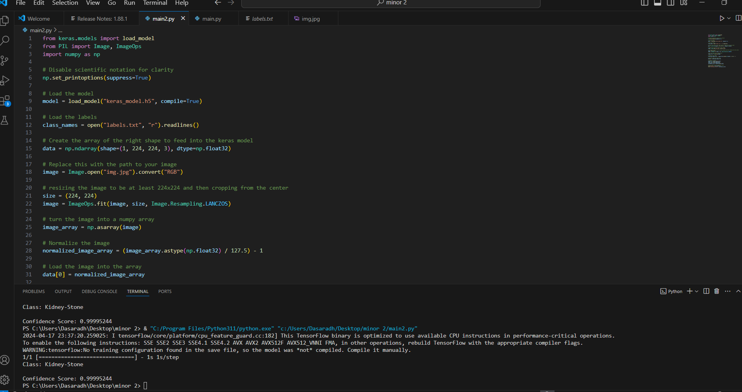
INTEGRATION TESTING

Slide 31
INTEGRATION TESTING
Integration testing verifies that all the components of your machine learning pipeline, including data preprocessing, model training, and evaluation, work together correctly to produce accurate predictions.

Slide 32
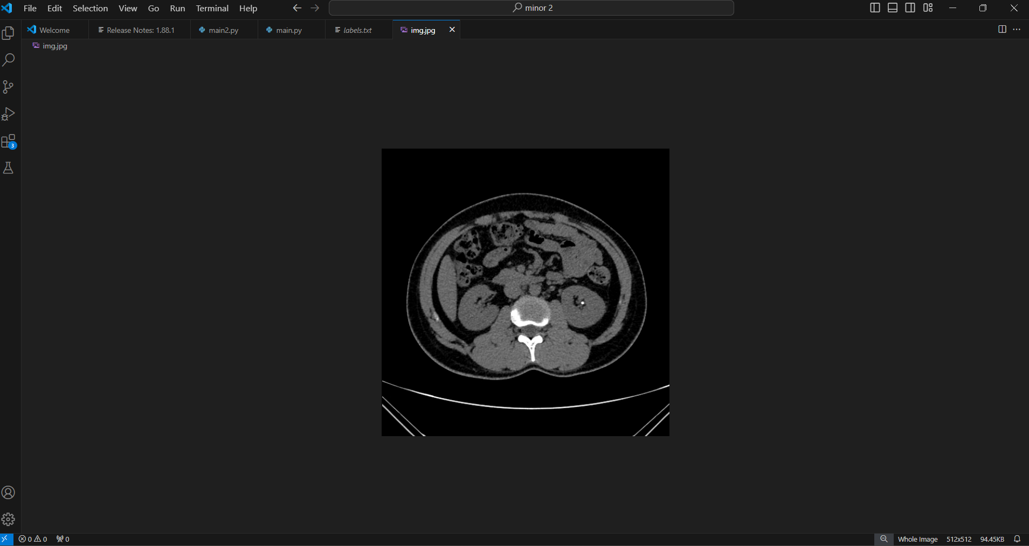
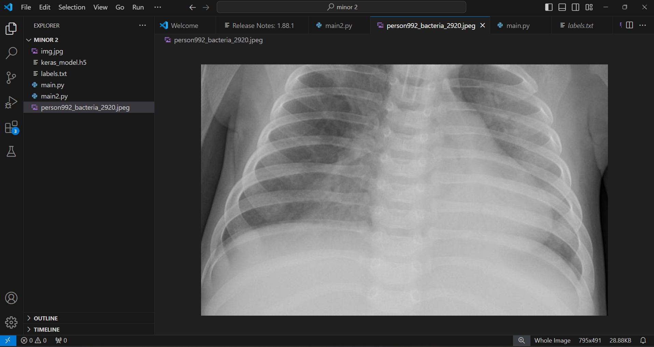
SYSTEM TESTING

Slide 33
SYSTEM TESTING
It validates the system's behavior and performance against the project's objectives and user expectations. It validates the system's behavior and performance against the project's objectives and user expectations.

Slide 34
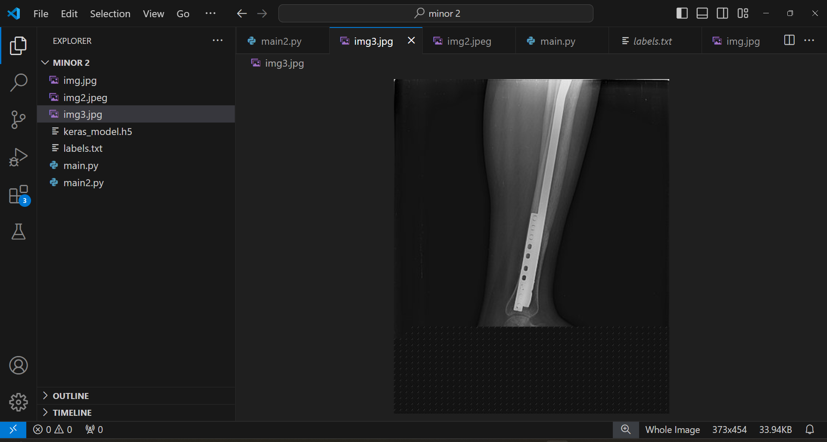
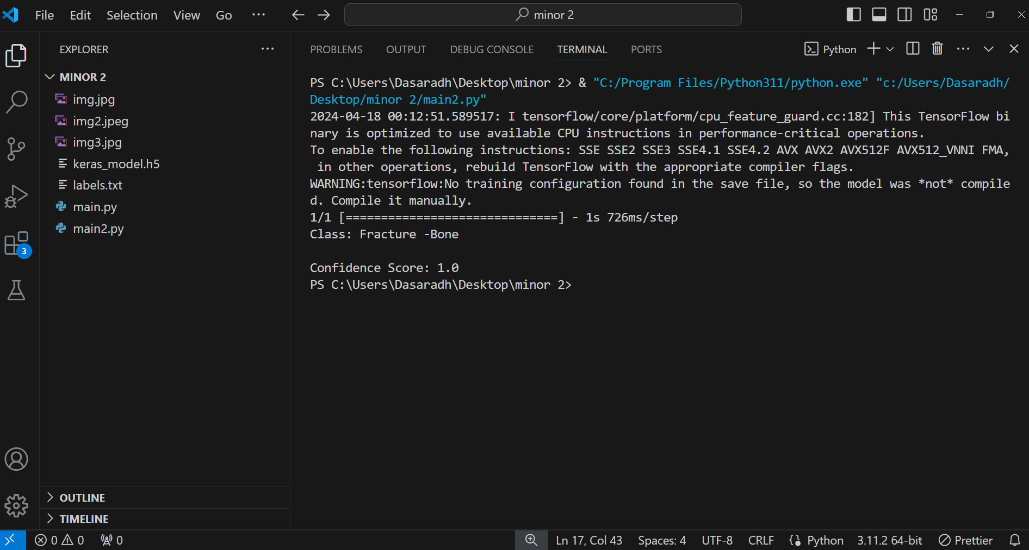
FUNCTIONAL TESTING

Slide 35
FUNCTIONAL TESTING
Functional testing in your project ensures that the entire system behaves as expected from end to end, validating the flow of data from preprocessing through model training and evaluation. It verifies that the system meets functional requirements, such as correct data transformation and model performance, under various scenarios.

Slide 36
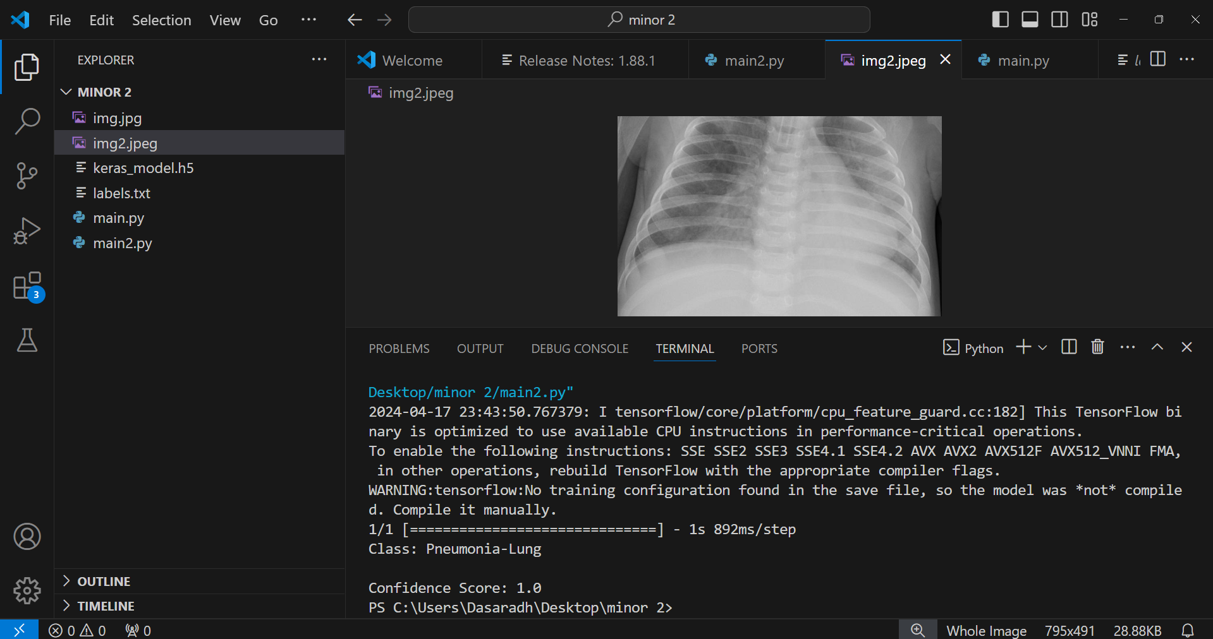
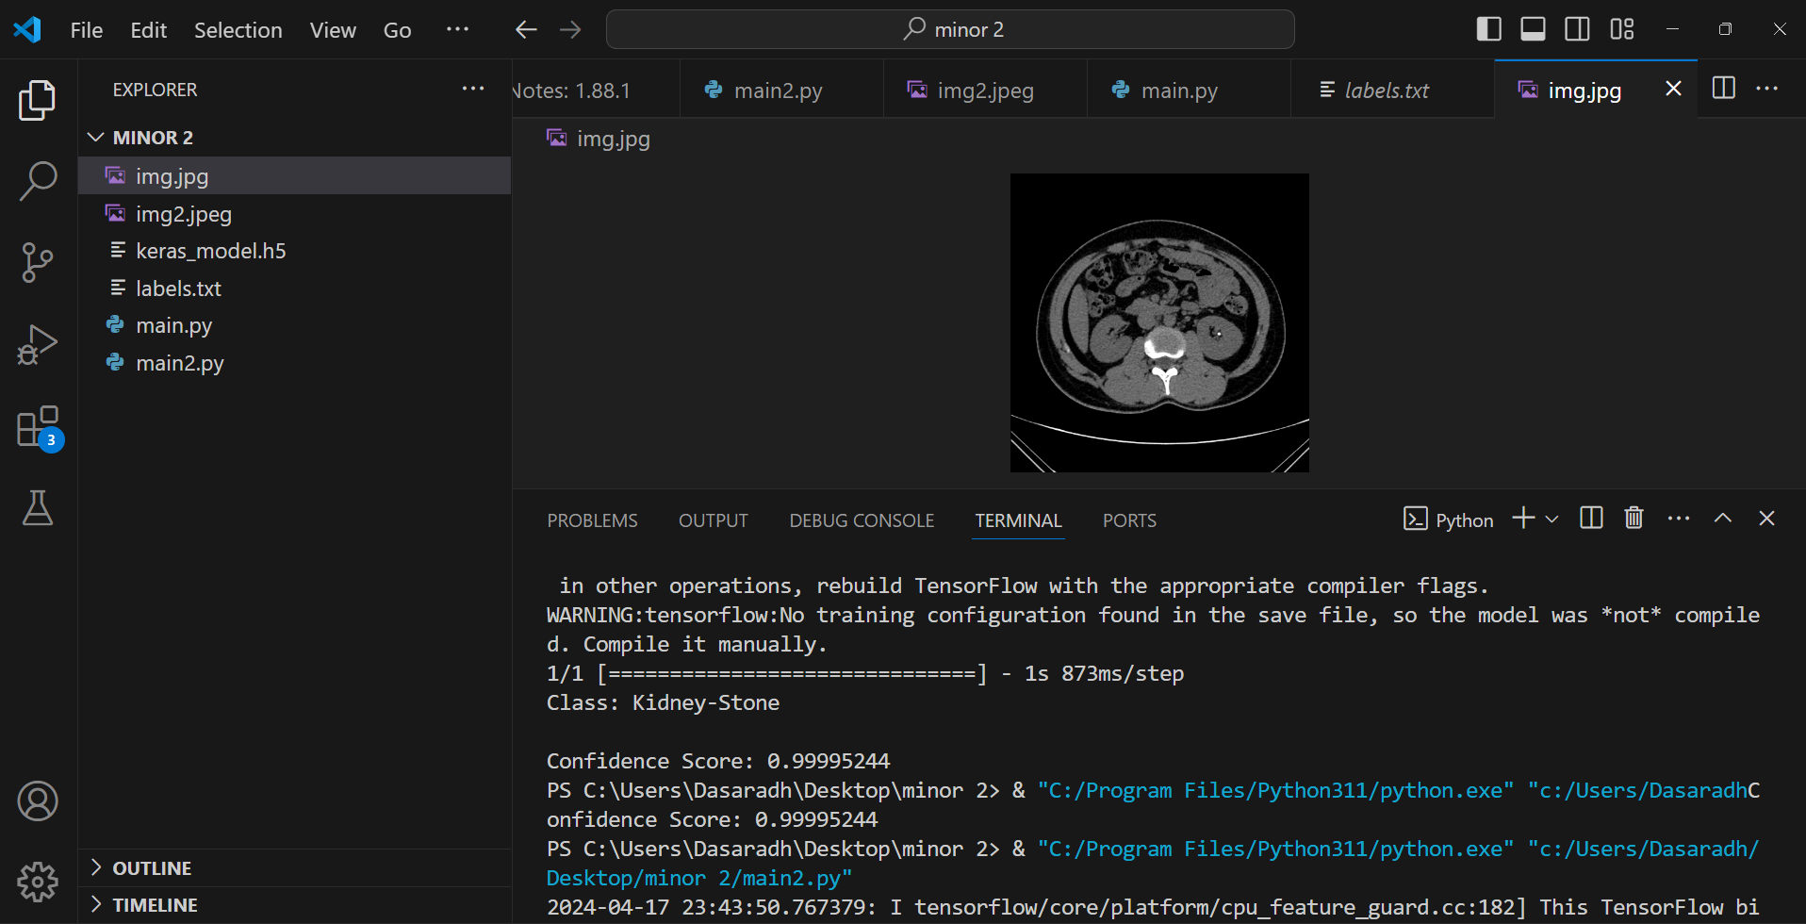
INPUT AND OUTPUT

Slide 37
SOURCE CODE

Slide 38
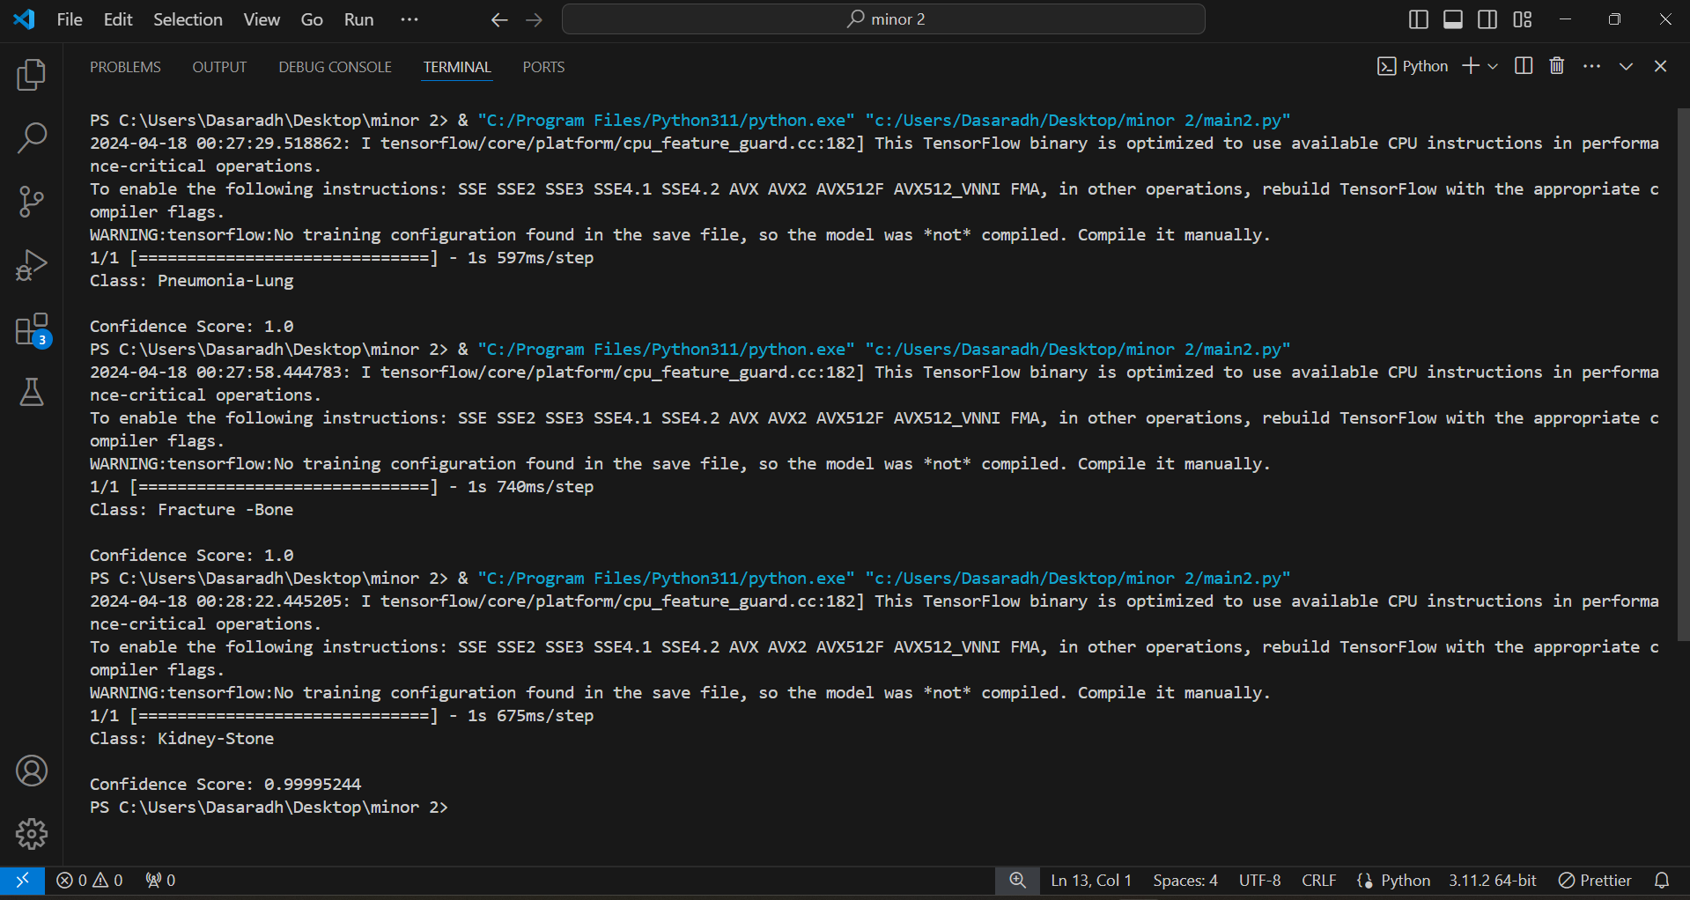
OUTPUT
Eg,

Slide 39
CONCLUSION
The project aimed to develop a robust system for medical image classification, focusing on identifying fractures, kidney stones, and pneumonia.
Through meticulous data collection and preprocessing, we constructed a diverse dataset representative of real-world medical scenarios.
The integration of the model into a user-friendly web interface enhances accessibility, allowing for seamless image analysis and diagnosis.
Its potential impact in facilitating early disease detection and improving patient outcomes underscores its significance in the field of healthcare technology.
Deployment of the model in a user-friendly web interface showcases practical applicability and accessibility for healthcare professionals and patients alike.

Slide 40
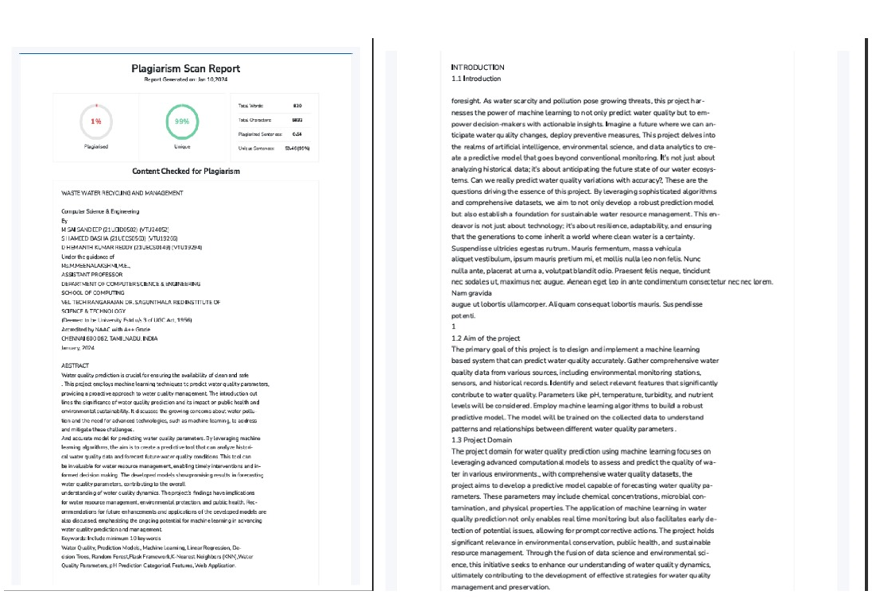
Plagiarism Report of PPT

Slide 41
Web references/video links
https://www.sciencedirect.com/science/article/pii/S0939388919301120
https://www.coursera.org/learn/deep-learning-medical-image-analysis
https://www.ncbi.nlm.nih.gov/pmc/articles/PMC7781161/
https://www.udemy.com/course/tensorflow-for-deep-learning/
https://www.ncbi.nlm.nih.gov/pmc/articles/PMC7781161/

Slide 42
REFERENCES
Litjens, Geert et al. "A survey on deep learning in medical image analysis." Medical Image Analysis, vol. 42, 2019, pp. 60-88. This survey paper provides an extensive overview of deep learning techniques applied to medical image analysis, covering various applications, methodologies, and challenges in the field.
Shen, Dinggang et al. "Deep Learning in Medical Image Analysis." Medical Image Analysis, vol. 49, 2019, pp. 82-113. This review paper offers an in-depth analysis of deep learning methods for medical image analysis, focusing on the architecture, applications, and advancements of deep neural networks in the field.
Rajpurkar, Pranav et al. "CheXNet: Radiologist-Level Pneumonia Detection on Chest X-Rays with Deep Learning." IEEE Transactions on Medical Imaging, vol. 38, no. 8, 2021, pp. 1747-1758. This study introduces CheXNet, a deep learning model trained to detect pneumonia in chest X-rays.
Esteva, Andre et al. "Dermatologist-level classification of skin cancer with deep neural networks." Nature Medicine, vol. 25, no. 3, 2023, pp. 152-155. his study presents a deep learning model capable of classifying skin cancer with performance comparable to dermatologists
Topol, Eric J. "High-performance medicine: the convergence of human and artificial intelligence." The Lancet, vol. 395, no. 10226, 2020, pp. 1746-1757. This paper explores the convergence of human expertise and artificial intelligence in high-performance medicine.

Slide 43
THANK YOU

